Slide 1









KAYLA’S
ADLERIAN LIFE
“Follow your heart, but take your brain with you.” Alfred Adler
By: Kayla Newkirk, MSED

Slide 2


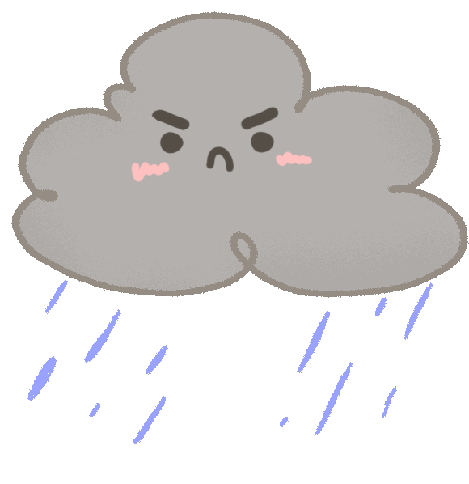




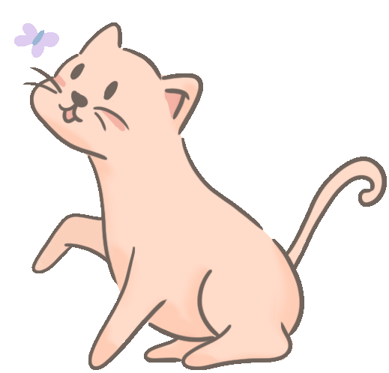
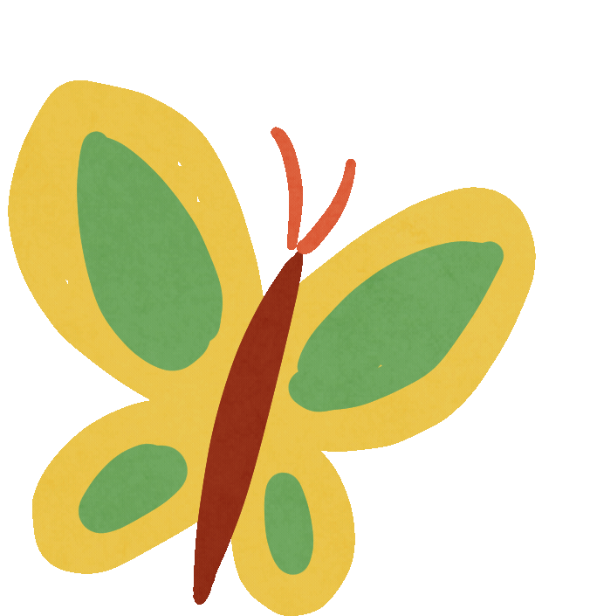
OVERVIEW
Introduction
Why Adlerian?
Adlerian Life Overview
Client Presentation

Slide 3

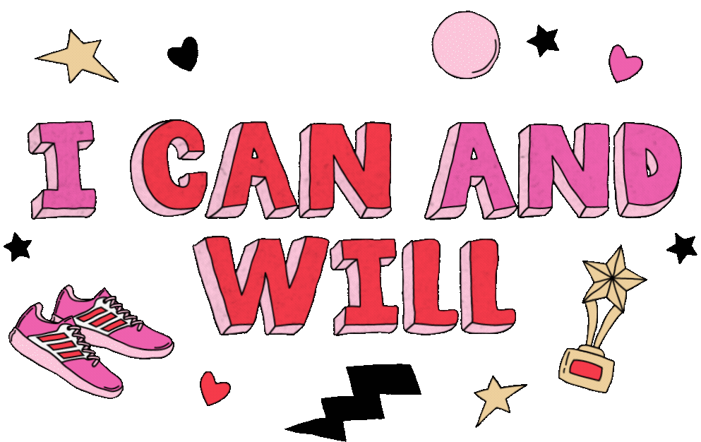


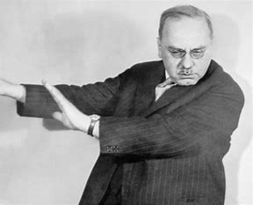

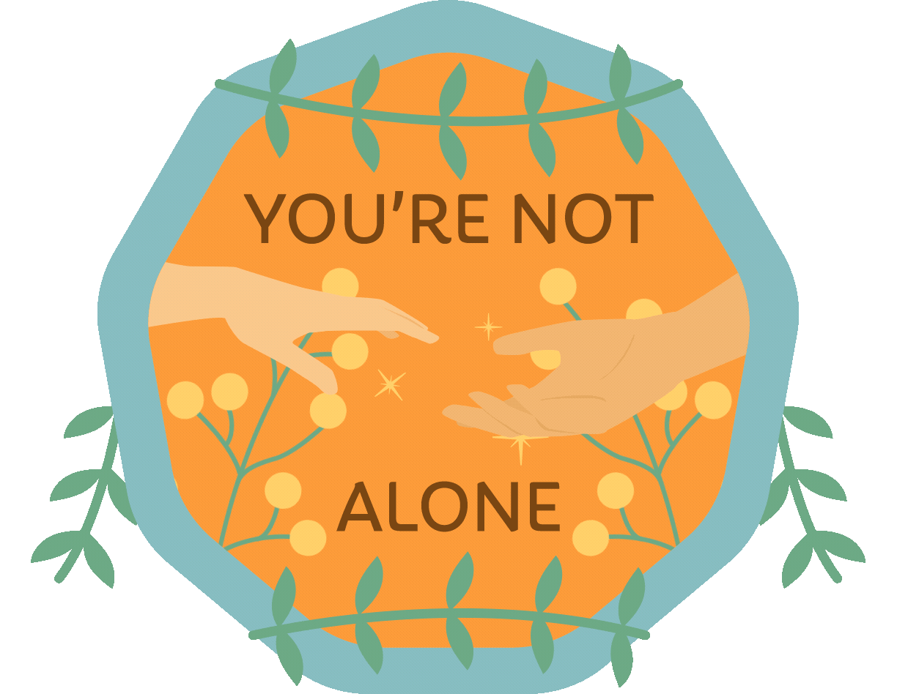

ADLERIAN
ASPIRATIONS
I use Adlerian Theory because this theory chose me before I could find it.
As I transitioned into adulthood, I was lost in my own unhealthy thoughts and behaviors. My life changed the day that my perception of how much autonomy I truly must create and chase my own goals through personal motivation. My personal responsibility drives me to achieve great things and allows me to give back to the multitude of communities that I love to be a part of.
Alfred Adler

Slide 4
ADLERIAN
ASPIRATIONS
Other reasons that I am an Adlerian:
Socialization
Egalitarianism
Personal responsibility and autonomy
Emphasis on family of origin and birth order
Giving back to the community or world before myself or I could become inherently selfish
People are not born with being “good” but can be later in life with healthy mindset and goals
Super interesting commonalities:
I am also horrible at math and was told to focus on other studies until I “needed” math!
Rules do not bind me; they guide me
I was also hit by a car as a child! (Age 7 for me, Age 5 for Adler)
Alfred Adler

Slide 5

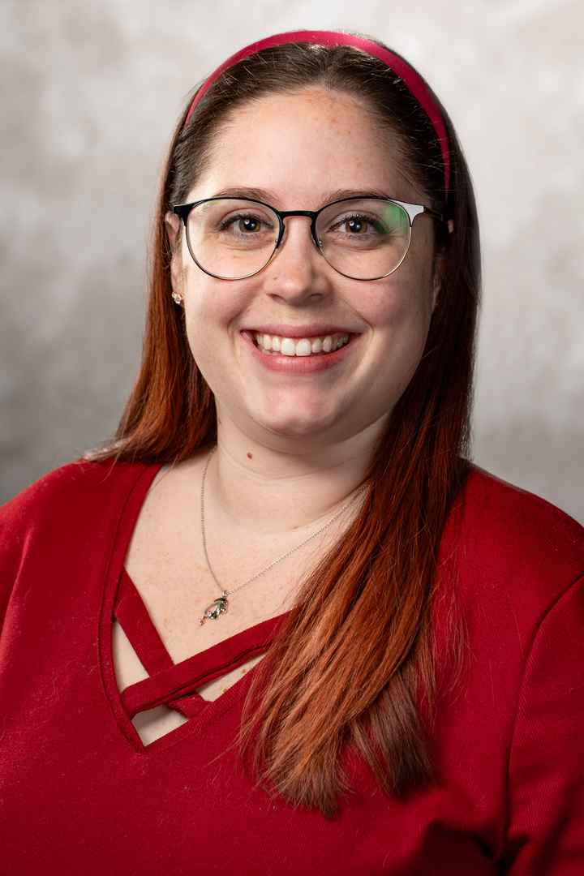


INTRODUCTING
Kayla Marie (Cordone)Newkirk

Slide 6

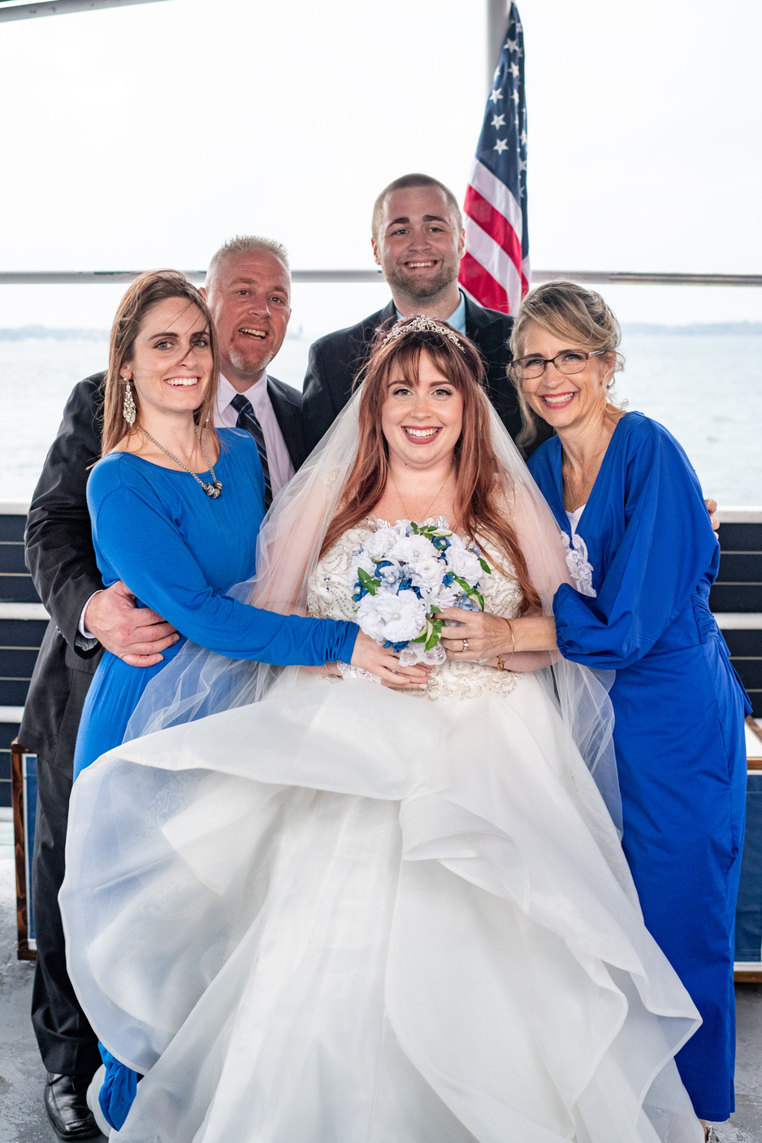
FAMILY OF ORIGIN
Meet the Cordones
Family of consisting of:
Shannon (mom)
Joel (dad)
Megan (older sister)
AJ (twin brother)
Me

Slide 7


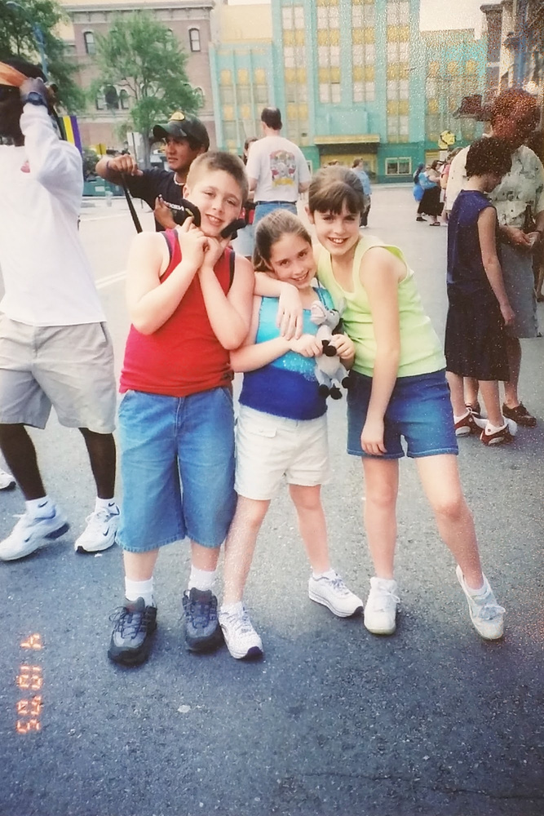
2
BIRTH
ORDER
Fun facts:
My sister Megan is two years older than us
She now lives in Virginia with her husband and two children
Our birth orders match the psycholoigcal birth order

Slide 8
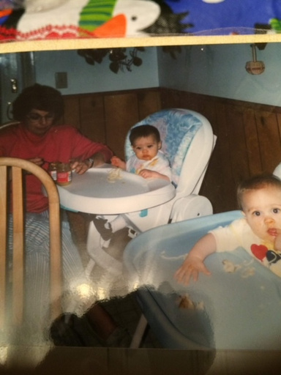
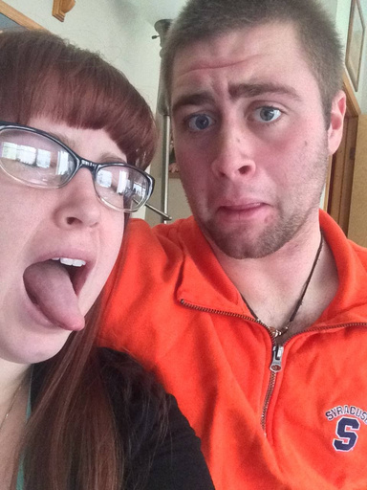
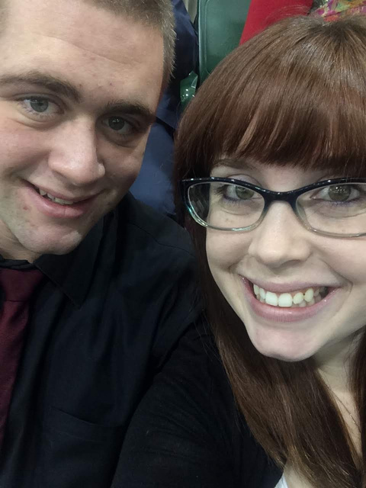
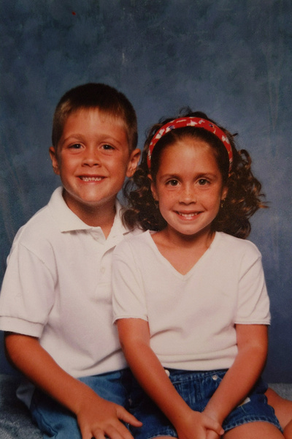
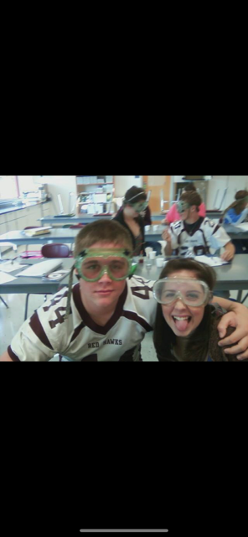
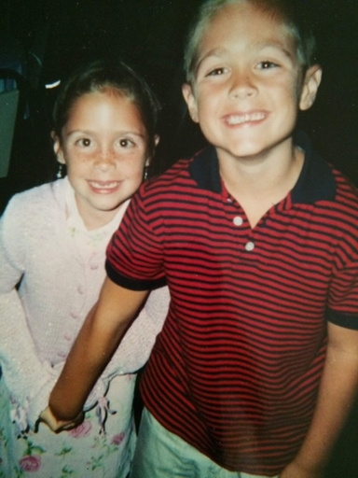
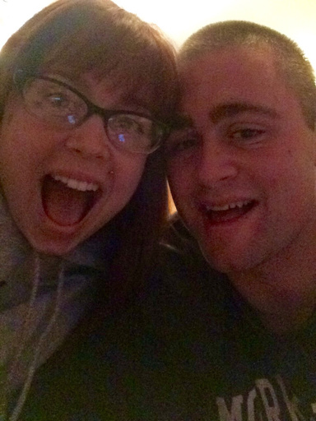
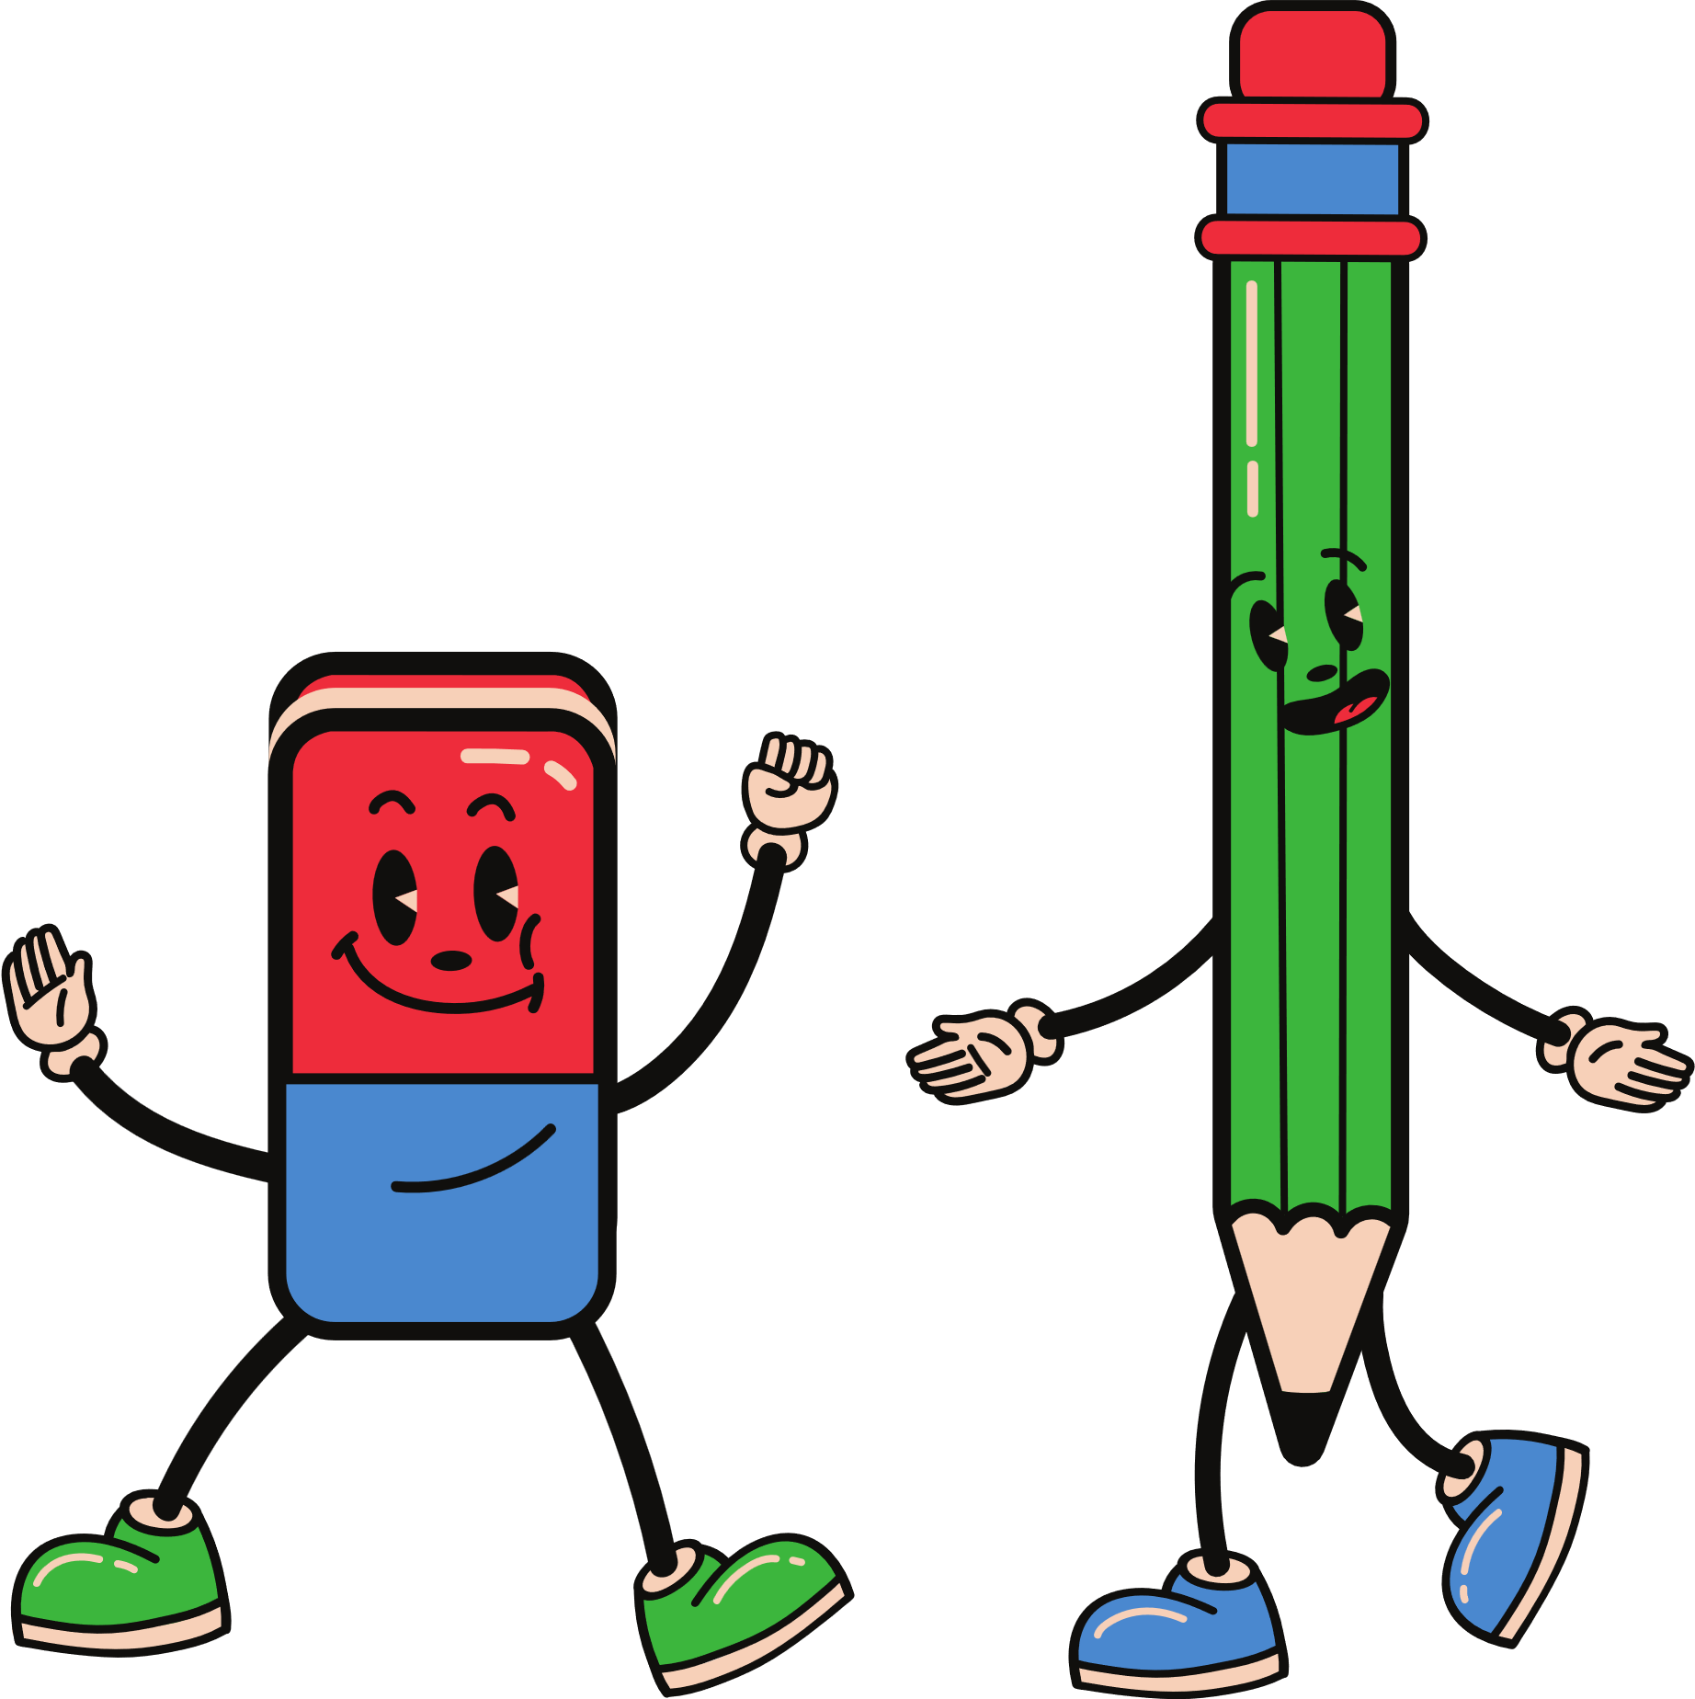
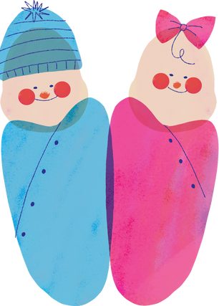
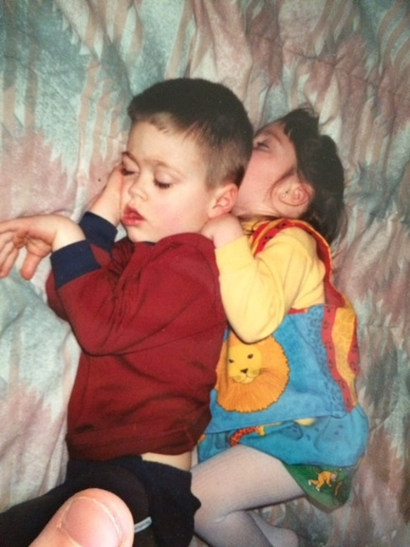
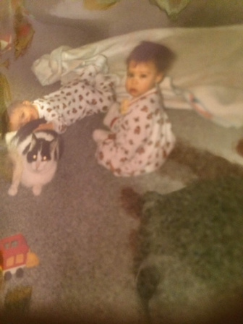
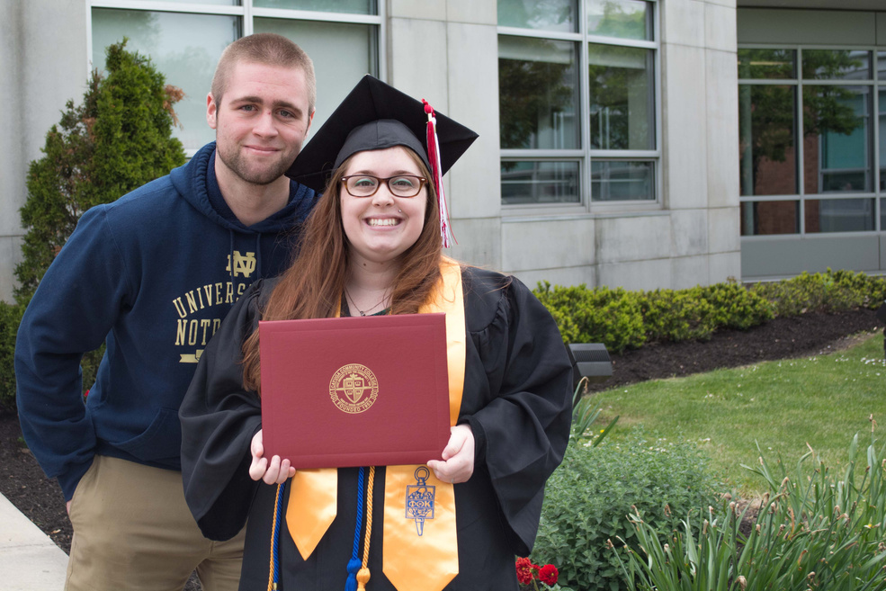
#TWINNING
Meet the Twinners
Fun Facts:
AJ is 7 minutes older
He is the only boy in our family
He is the complete opposite of me! (height, interests, intelligence, lifestyle, etc.)
We had our own secret language growing up until the age of 6 or so
We were separated a lot in school in fear of not being social with other kids
We have lived in different states twice as adults, but still stay in touch
We have a matching tattoo! (Have you seen it?)

Slide 9
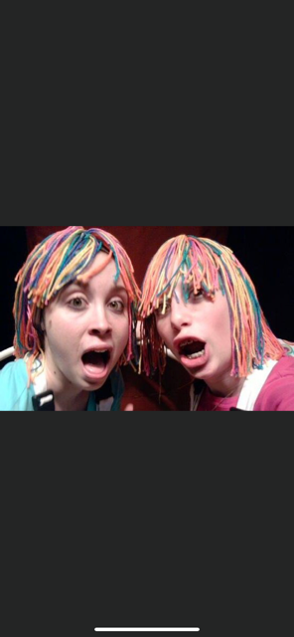
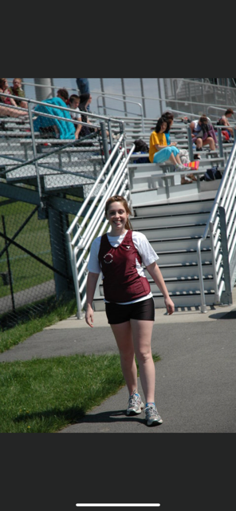
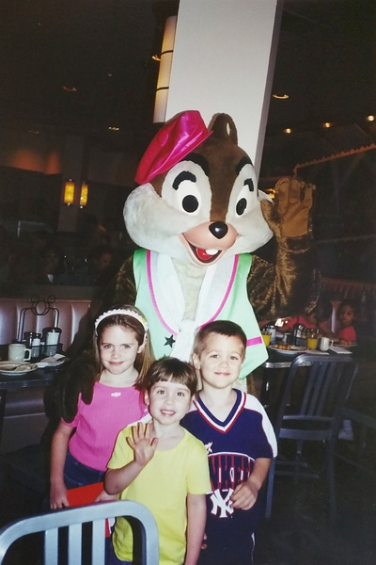
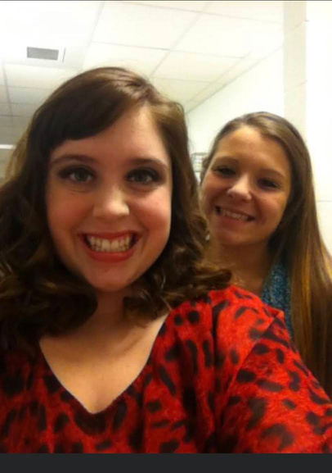
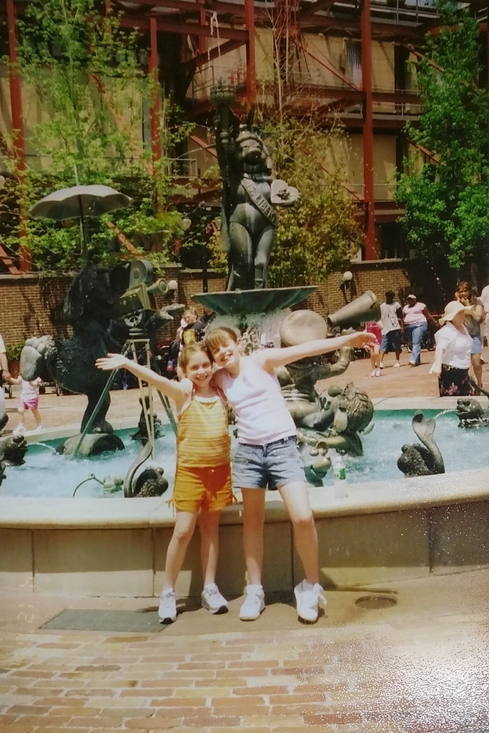
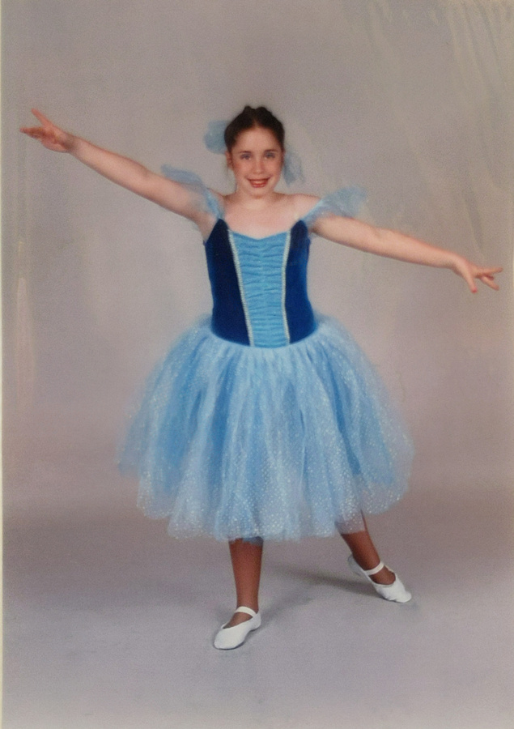
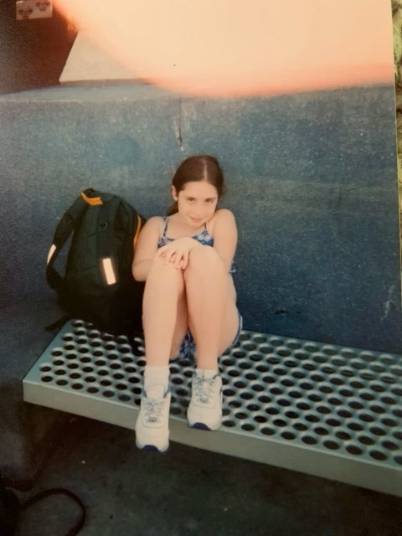
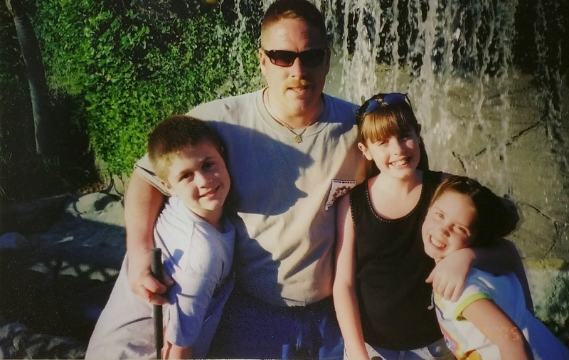
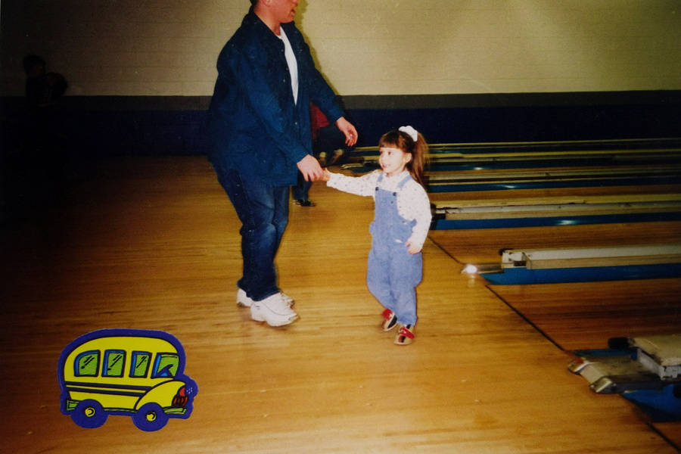
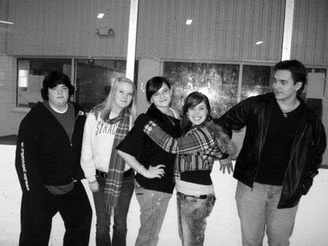
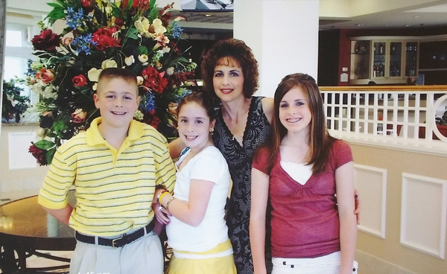
EARLY
RECOLLECTIONS

Slide 10



MY PERSONALITY PRIORITY
Superiority | Competency/Useful | Status
ASSOCIATE’S DEGREE | CAYUGA COMMUNITY COLLEGE
BACHELOR’S DEGREE | SUNY GENESEO
MASTER’S DEGREE | ST. BONAVENTURE UNIVERSITY
Ph.D. (!) | WAYNESBURG UNIVERSITY
Total Mastery
Status :
In Progress
Achieved

Slide 11

LIFE TASKS
Superiority | Fulfillment | Status
LOVE | HAPPILY MARRIED - 11 YEARS TOGETHER!
WORK | HAPPILY CONTRIBUTING AND LIFE-LONG LEARNING!
FRIENDSHIP | DEEP, MEANINGFUL, AND FULFILLING!
SELF | PEACE WITH IDENTITY
SPIRITUALITY | A WORK IN PROGRESS!
Status :
In Progress
Achieved
Total Mastery

